Slide 1

Transform your managed services business with IBM PureFlex and Flex System
Notes:
1
This deck of charts helps us discuss the value proposition of IBM PureFlex and Flex System to the Managed Service Provider (MSP) market segment.

Slide 2




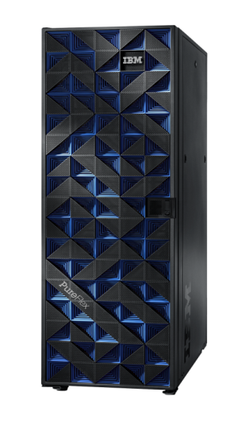
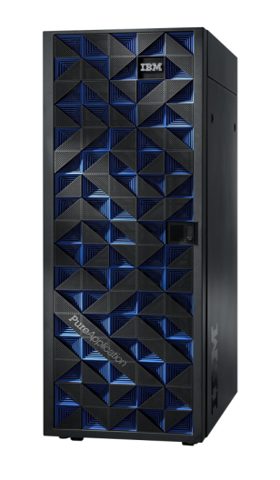


IBM PureSystems family enhances the value of IBM’s x86 computing solutions for MSPs
Management
Infrastructure
Delivering Infrastructure Services
Application Platform
Delivering Platform Services
Data Platform
Delivering Data Services
Compute
Networking
Storage
Notes:
IBM PureSystems family provides flexible choice with Flex System and provides the benefits of built-in expertise, integration and simplified experience with PureFlex. Pure Application and PureData provide the application and data platform for client specific applications. We will focus our discussions on PureFlex and Flex System in the subsequent charts.

Slide 3



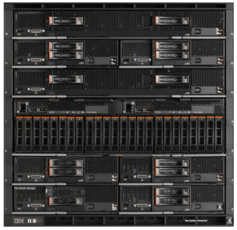
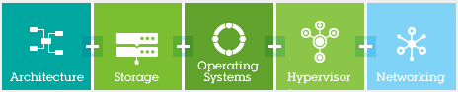

IBM is uniquely positioned to offer value and choice
You choose
Pre-integrated
Infrastructure Components
Integrated Infrastructure
Beyond Blades
Delivering Infrastructure Services
Investment protection
Designed for the next decade, no compromises
Works with your existing systems
Beyond blades
Compute, storage, networking, management
Designed and tested for inter-operation
Simplification
Management of physical and virtual domains
Single point of management
Competitive differentiation
Choice of architectures, hypervisors, operating systems
Leading management
Time to value
Pre-integrated, set up in as little as 4 hours
Pooled resources, deploy new services rapidly
New solutions and applications
Leading ERP, CRM, tens of thousands of available apps.
Key solutions e.g. Virtual Desktop Infrastructure
Simplification
Expert integrated system
IBM expertise from optimizing thousands of data centers
Competitive differentiation
Comprehensive – storage, networking, compute
Partner ecosystem

Slide 4



PureFlex & Flex System help MSPs address technology challenges
Proven Technology with
Open & Flexible Architecture
Industry’s most powerful platform designed for the next decade
Offers flexibility to design datacenters with heterogeneous workloads & hypervisors
Supports both x86 & Power compute nodes
High Availability Solutions
Flex System Manager monitors hardware & automates movement of workloads
Flex System Manager communicates with vCenter to move virtual machines from
failing servers
Comprehensive Tools
Flex System Manager is a single point of control managing all clients’ hardware & virtualization requirements while reducing workload management complexity
Notes:
This slide explains how IBM PureFlex and Flex System meet the most important technical needs of MSP, providing proven flexible architecture technologies, high availability and comprehensive systems management tools.

Slide 5

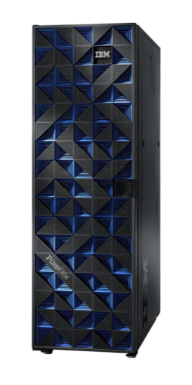

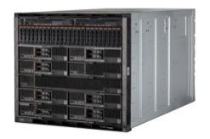
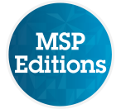

New IBM PureFlex and Flex System Managed Service Provider Editions deliver cloud services faster for less cost
Accelerate cloud deployment up to 66% faster¹
Faster provisioning of multiple architectures / OS with the FSM
Financing that enables margin growth and cash flow management
Announcement Details
PureFlex / Flex System editions include NEW reference configs tailored for MSPs:
Remote monitoring
Recovery services
VDI Services
Patch management
Help desk
Financing and support just for MSPs
Enhanced partner enablement for co-marketing, education and best practices thru PartnerWorld
Reference Configs
PW MSP program
Financing
Marketing launch pad
Partner Integration Services*
ISV ecosystem
SmartCloud offerings
Build to Order Configs
PW MSP program
Financing
Marketing launch pad
Partner Integration Services*
ISV ecosystem
SmartCloud offerings

Slide 6
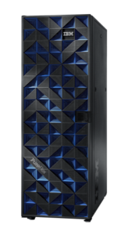

IBM PureFlex and Flex System MSP Reference Configurations Samples of the five solutions for MSPs
Pre-integrated servers, storage, networking, virtualization and management
Infrastructure components
“Beyond Blades”
Infrastructure
Optimized to deliver Cloud Services
PureFlex Express, Standard or Enterprise
Small (128 VMs), Medium (640 VMs) and Large (2176 VMs) reference configurations
Flex System Manager Node
IBM Networking
Storwise V7000 Storage
Choice of x86 or POWER 7+ Compute
IBM Lab Services or BP Service offerings
IBM Flex System – customizable choice
Choice of x86 or POWER 7+ Compute
IBM Networking (10GbE, FCoE, FC)
Flex System Manager
Software Services
IBM SmartCloud Offerings
Provisioning
Monitoring
Cost Management
Tivoli Storage Manager Recovery
Citrix XenDesktop
VMware View
Virtual Bridges
Patch Management
Control
Desk
Managed IT Solutions
Delivering IT as a Service
Remote Monitoring Cloud Service Delivery
Managed Storage Backup and DR Services
Virtual Desktop Services
Patch Manage the Cloud
Deliver Help Desk Services
Defined infrastructure configurations
Available in IBM SW catalog
MSP Delivered Service
Notes:
6
PureFlex & Flex System are designed to support MSPs for cloud, hosted and managed IT deployment models. Our servers support multi-tenancy & multiple hypervisors for virtualization and are thus suitable for cloud deployments. SmartCloud Entry solution help accelerate cloud deployments. PureFlex and Flex System servers can be quickly deployed and migrating workloads is simple. There is no need for ‘rip and replace’.

Slide 7
PureFlex & Flex System fully support MSP requirements
Critical
Desirable
Supports Multiple Customers
Supports MSP’s managed, hosted, and public cloud deployment models.
Ease of Buying & Support
IBM’s leading end-to-end service capabilities, a “single number to call” for fast support and skills for quick resolution to support questions.
Scalability/Up grade roadmap
Scalable portfolio and components designed for the next generation of computing that alleviate ‘rip and replace’ expansion.
Service Oriented Architecture
PureFlex and Flex System deliver scalable IT that enables MSP to add IT resources as the business grows.
Ease of Managing
Flex System Manager is a single point of control for managing networking, storage, virtualization & compute node requirements.
Ease of Integration
Designed to integrate into existing MSP infrastructure environment.
Quick Deployment
Factory integration of compute, storage, networking & management enables MSP to quickly deploy PureFlex solutions.
Works with multiple Operating Environments
Supports multiple OS (AIX, Linux, Windows) and multiple hypervisors (PowerVM, KVM, Hyper-V).
Delivery Models
PureFlex delivers IaaS (Infrastructure as a Service); Flex System is custom tuned and delivers optimum flexibility.
Security & Compliance
PureFlex & Flex System, built on a Trusted Computing Base (TCB), increase vital platform infrastructure and firmware-level security.
Virtualization & Cloud ready
PureFlex Standard & Enterprise include SmartCloud Entry; multiple hypervisor support complements varied virtualization requirements.
Availability & Reliability
PureFlex’s single, automated and optimized management platform provide MSP with the ability for gain workload level availability
Notes:
This chart maps the attributes of PureFlex and Flex System to the critical and desirable MSP requirements. On all counts of MSP requirements, PureFlex and Flex System score very well. Easy to buy and integrate with existing MSP infrastructure and easy to manage, are key attractions, while scalability, security and resiliency aspects make PureFlex and Flex System winners in MSP environments.

Slide 8





MSPs value PureFlex offerings for their businesses
Business Need: Solution hosting with a high level of performance while continuing to provide easy-to-use IT services to their customers
Business Need: Support its channel of business partners with client customized web portals enabling MSP to create cloud services and deliver them to their own customers as "white-label" solutions
Solution: IBM PureFlex provides an x86 infrastructure with IBM software that is ready for Platform as a Service (PaaS) Cloud and allows Enfo to reduce their VM Ware licensing costs.
Solution: IBM PureFlex System with x240 servers, SmartCloud Entry and Flex System Manager maximizes capacity and allows partners to be responsible for the solutions delivered.
Platform-as-a-Service
Managed Service Provider
Business Need: Croatia-based Altus needed to transform from a data center services provider to a cloud services provider
Business Need: Deliver Ready for PureSystems solution in SaaS model using a cloud-ready platform with fully integrated server, storage and network
Solution: Selected IBM PureFlex in order to make better utilization of existing datacenter space and be able to provide more diverse and higher value services
Solution: The cloud-ready platform allows DynaFront to offer customers usage-based pricing while simplifying system management and billing
Managed Service Provider
Software-as-a-Service
Notes:
ENFO:
Enfo, an IBM Business Partner, signed a Flex System deal as a result of the first PureFlex Benchmark conducted at the IBM Montpellier Products & Solutions Support Center (PSSC). This was a competitive win against HP/Cisco/Dell, and included IBM hardware and software.
The IBM Flex System is an advanced Blade architecture and provides a great entry point into the PureSystems family, with an upgrade path to IBM PureFlex.
Why IBM Flex Systems
This HP and VMware customer wanted to acquire new x86 infrastructure ready for Platform as a Service (PaaS) Cloud. It also wanted to reduce VMware licenses costs. Enfo was interested in the IBM PureSystems technology as soon as it was announced. A visit to see PureSystems in action at the Montpellier center showed Enfo that the anticipated benefits of an IBM approach would also work in practice. This had an enormous effect on the client's decision to purchase the solution.
The benchmark results convinced the customer they could trust the technology. Shortly after the visit to Montpellier, Enfo decided to buy their first Flex System Chassis. The IBM proposal included a solution based on IBM Flex System and KVM hypervisor with an easy migration path and readiness for Private PaaS Cloud.
Performance: A successful benchmark led to the deal closing in June 2012. A Total Costs Reduction Study accurately reflected savings and highlighted the overall financial gain.
Ease of Use: The solution will simplify the customer environment with KVM, VmWare hypervisor and SLAS through a single interface.
Trust: IBM won this deal because this customer trusts us. Enfo knows that IBM will be there to help with any challenges they have.
Partnership: Our local pre-sales and maintenance teams have worked closely with the customer to solve problems together with help from our support and lab teams.
Background
Enfo is a Managed Service Provider that offers companies and communities with easy-to-use IT services in Nordic countries. Enfo utilizes its more than 45-years of experience in the development of IT services and uses the best hardware and software available.
Almost 800 IT experts ensure that Enfo's customers get the best out of their IT. Enfo's main IT partners are HP, Microsoft, Symantec and IBM.
The Solution
The first Flex System order included Enterprise Chassis and three x240-nodes with 4 cores. Enfo will also buy Flex System Manager later this year.
In addition, Enfo ordered XIV Gen 3 extension (3 modules) and Smart Cloud Provisioning -licenses for 162 servers at this point.
This deal may serve as an entry point to an even larger footprint as Enfo still has about 2000 physical HP servers.
DynaFront:
DynaFront is a software solution and consulting company providing innovative solutions to insurance companies throughout the Asia-Pacific region. It specializes in developing and deploying life insurance applications using a range of proven technology platforms, from Java-incorporated web-based applications to dynamic database systems. Combining technology competencies and industry domain knowledge, DynaFront helps customers gain measurable business advantages and maximize return on technology investments. DynaFront became Malaysia’s fourth ISV Business Partner in 2002 and achieved IBM Insurance Industry Framework validation in 2010.
IBM Systems and Technology Group Lab Services is helping DynaFront set up its PureFlex System platform using the following components:
Three IBM Flex System x240 Compute Node servers running the Microsoft Windows Server 200x operating system
Two IBM Flex System p260 Compute Node servers running the IBM AIX V7.1 operating system
Two IBM Flex System Fabric EN4093 10Gb Scalable Switch devices
Two IBM Flex System FC3171 8Gb SAN Switch devices
An IBM Storwize V7000 disk system
DynaFront is integrating its DynaFront PrecentiaLife application with IBM WebSphere Application Server and IBM DB2 information management software. Global Technology Services is helping implement disaster recovery facilities using a high-availability cluster model. Further, Global Financing provided competitive financing for the solution.
DynaFront plans to launch its new offering as a hosted managed service in September and subsequently realize multiple benefits. First, the ISV is prepared for customers to embrace the new cloud-based solution and estimates the solution will generate USD3 to USD4 million in first-year sales. By taking advantage of virtualized IBM hardware resources, DynaFront can speed customers’ time to value through rapid deployment, more easily scale the solution to meet their needs and offer attractive pay-as-you-go pricing options. Second, the PureFlex System platform simplifies system management and billing for DynaFront, which can oversee all virtualized resources from a single console plus control its middleware and runtime environment. Finally, DynaFront can accelerate its own sales cycle by capitalizing on its Ready for IBM PureSystems solution certification and go-to-market support from IBM.
ALTUS
An IT services provider in Croatia reduces product-development time by 60 percent and improves the performance of its IT infrastructure while simplifying its management when it joins forces with IBM Premier Business Partner Business Computer Systems to implement IBM Flex System technology, an IBM System Storage device and IBM Systems Director software to transform its business from a data center services provider to a cloud-computing services provider
Business need
Altus Information Technologies (Altus) wanted to transform its business from a data center services provider to a cloud-computing services provider. This, it recognized, would better use its physical data center space and allow the company to provide more diverse services. Altus needed to implement a flexible, scalable and efficient cloud-ready infrastructure to make this change and prepare for future growth.
Solution implementation
To implement a cloud-ready infrastructure, Altus joined forces with IBM Premier Business Partner Business Computer Systems (BCS) to create a solution based on IBM Flex System compute nodes and an IBM System Storage device, complemented by IBM Systems Director software. BCS used four IBM Flex System x240 compute nodes as a virtualization platform to create multiple virtual machines (VMs) for Altus. The client can host numerous customers on the VMs, which reside on the same hardware, while logically separating their respective applications. BCS connected an IBM Storwize V7000 disk system to the compute nodes using IBM Flex System FC3171 SAN and IBM Flex System EN2092 Ethernet Scalable switches. This configuration unifies and virtualizes the disparate storage devices from various vendors in the incumbent infrastructure, enabling Altus to use its existing devices and apply its past investments. The Storwize V7000 device is equipped with solid-state drives (SSDs) to enable flexibility and better service to its customers. Finally, BCS implemented IBM Systems Director Express Edition software to monitor the servers and virtual environment. The software enables Altus to make software and system updates as needed. The client uses the solution to monitor system health, using the software's threshold and error alerts to make proactive changes before problems arise.
Benefit of the solution
By joining forces with IBM Premier Business Partner BCS to implement IBM Flex System technology, an IBM System Storage device and IBM Systems Director software, Altus successfully transformed its business from a data center services provider to a cloud-computing services provider. Altus improved the performance and simplified management of its IT infrastructure with the fully integrated solution, and reported a 60 percent reduction in product-development times for its customers' new services.
Computer Gross:
Computer Gross Italia S.p.A. is a distributor of hardware, software and networking solutions, including IBM solutions. Headquartered in Italy, the company employs over 350 people and operates through a channel of over 7,000 partners.
Enabled Solution – IBM PureFlex System with IBM Flex System x240 servers in its data center to support its channel of business partners with MSP customized web portals.
The IBM Flex System Manager enables MSPs to create cloud services and deliver to their own clients, providing "white-label" solutions that maximize capacity and allows partners to be responsible for the solutions delivered.
Business need:
Need flexible cloud solutions and services for downstream partners
Needed to deploy an integrated, centralized infrastructure
Provide business-focused software and infrastructure services
Benefits:
Flexible and expandable IaaS hosting
Provisioning on demand saves time, cost
Federated hosting makes an affordable enterprise-class infrastructure with cloud-based services

Slide 9


IBM Flex System with SmartCloud Entry delivers an expandable hosted cloud services platform to Computer Gross Italia S.p.A.
Business challenge
Need flexible cloud solutions and services for downstream partners
Needed to deploy an integrated, centralized infrastructure
Provide business-focused software and infrastructure services
Client benefits
Flexible and expandable IaaS hosting
Provisioning on demand saves time, cost
Federated hosting makes an affordable enterprise-class infrastructure with cloud-based services
Solution summary
IBM PureFlex Express with IBM Flex System x240 servers in its data center to support its channel of business partners with MSP customized web portals.
The IBM Flex System Manager enables MSPs to create cloud services and deliver to their own clients, providing "white-label" solutions that maximize capacity and allows partners to be responsible for the solutions delivered.
More information
Link to the case study
Link to the video
Cloud Solutions Page
Computer Gross Italia S.p.A. is a distributor of hardware, software and networking solutions, including IBM solutions. Headquartered in Italy, the company employs over 350 people and operates through a channel of over 7,000 partners.
Notes:
This is an example of how IBM Flex System with SmartCloud Entry deliver an Infrastructure-as-a-Service solution used as a hosted cloud services platform by Computer Gross Italia S.p.A. and its partners. Computer Gross Italia S.p.A. is a computer hardware, software and networking solutions distributor moving to MSP business model, using this IBM solution to deliver cloud services.

Slide 10
IBM Flex System delivers cloud services platform to Logista (USA) with a SmartCloud suite, rich with Managed Services features
Business challenge
Needed a complete cloud solution comprising hardware, software & services.
Requirements included scalability and flexibility, as its plan called for starting small and growing rapidly.
Needed a partner recognized and respected in the IT community
Client benefits
IBM Flex System management simplifies system configuration & ongoing operations
Scalable PureFlex system hardware runs Intel and IBM Power nodes simultaneously
Ability to deliver reliable cloud services using a solution from IT industry leader
Solution summary
IBM PureFlex Enterprise Edition System with nine computing nodes: seven IBM Flex System x240 nodes and two IBM Flex System x220 nodes.
IBM SmartCloud Provisioning software which adapts to the available hardware; IBM SmartCloud Cost Management software that allows reporting with granular detail of usage; IBM SmartCloud Monitoring software; VMware with 200 virtual machines
More information
Integrated Solution
Cloud Solutions Page
The company has offices in Alabama, Florida, Georgia, Mississippi and Tennessee and supports businesses of all sizes with a full range of hardware, software and IT services, including systems integration
Notes:
Logista is using IBM Flex System to deliver cloud services, as it expands its hardware, software and IT services business to deliver managed services to its clients. NOTE: ‘Pending approval for inclusion in the Client presentation’.

Slide 11
Why IBM PureFlex & Flex System for MSP workloads
Faster to deploy and manage VMs
for cloud
Integration & built in expertise: ideal platform for virtualization
Virtualization expertise: enables new application and service delivery models
1
Easier to manage IT
complexity
Simplified experience: with advanced automation
Virtualization management: with automated VM placement
Dynamic provisioning: storage and network resources to ease migration
2
Scalable as MSP business grows
Easy upgrade: no “rip & replace” of traditional rack servers (chassis architecture)
Scalable networking: add network resource as MSP business grows
Investment protection: designed to support future generations of technologies
3
Easier to optimize MSP workloads
Speed to deployment: faster initial virtual workload deployment
Virtual patterns: pre-packaged workload expertise to speed & standardize
workload deployment
4
New MSP Editions Available
PureFlex and Flex System Solution examples
Financing and support just for MSPs
Tailored PartnerWorld programs for co-marketing and support
5
Notes:
This one pager describes the top reasons why MSP would choose to deploy IBM PureFlex and Flex System. Faster to deploy for cloud infrastructure, simple to manage, cost-effective, scalable and workload optimized are the main attributes of IBM PureFlex and Flex Systems that attract MSPs in selecting these servers.

Slide 12
声明：
所有的版权属于原有公司，文件均来自公开渠道
此文件仅供学习使用，任何人不得进行以此为商业目的的行为
如有疑问，请立即删除
学习世界五百强和咨询公司PPT课程请访问如下网站搜索：“司马懿”
百度传课：司马懿PPT学校
网易学堂：司马懿PPT学校
知乎： 司马懿PPT学校
访问地址
https://www.chuanke.com
访问地址
https://study.163.com
访问地址
https://www.zhiu.com

